Slide 1
Barbarian Prince
April 30, 2024

Slide 2
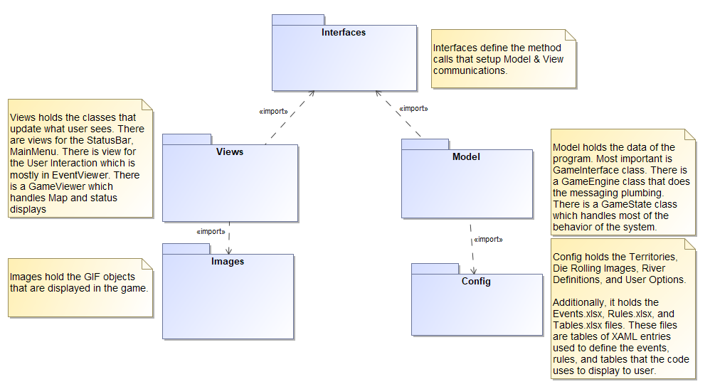
Architecture
Implement a Model-View-Controller (MVC) architectural pattern. Per “Pattern-Oriented Software Architecture” by Bushmann, Meunier, Rohnert, Sommerland, Stal, dated 1996
The MVC divides an interactive application into three components. The model contains the core functionality and data. Views display information to user. Controllers handle user input. Views and controllers together comprise the user interface. A change propagation mechanism ensures consistency between user interface and the mode.
Due to Windows Presentation Foundation (WPF) frameworks, the controller functionality resides in same class as the corresponding view.

Slide 3

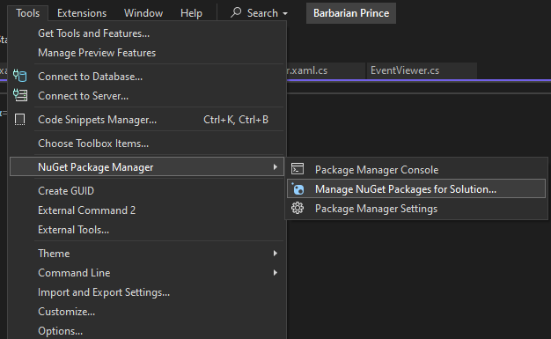
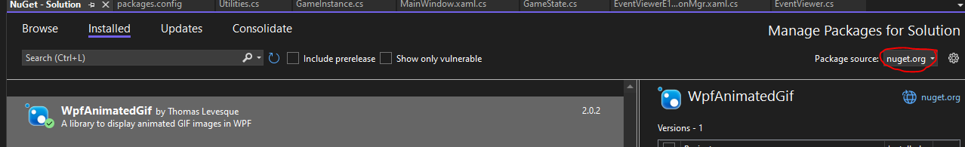
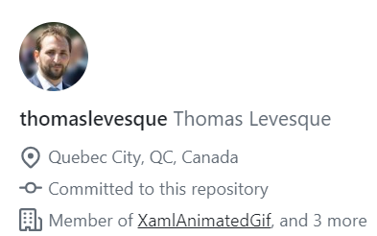
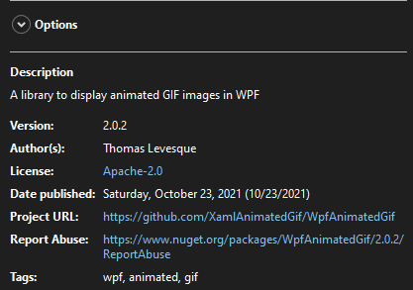
Architecture
Barbarian Prince uses the WpfAnimatedGif package provided by NuGet
Handles animated GIFs
Must download from NuGet Package Manager to compile the project
Apache License 2.0
Thanks Thomas

Slide 4
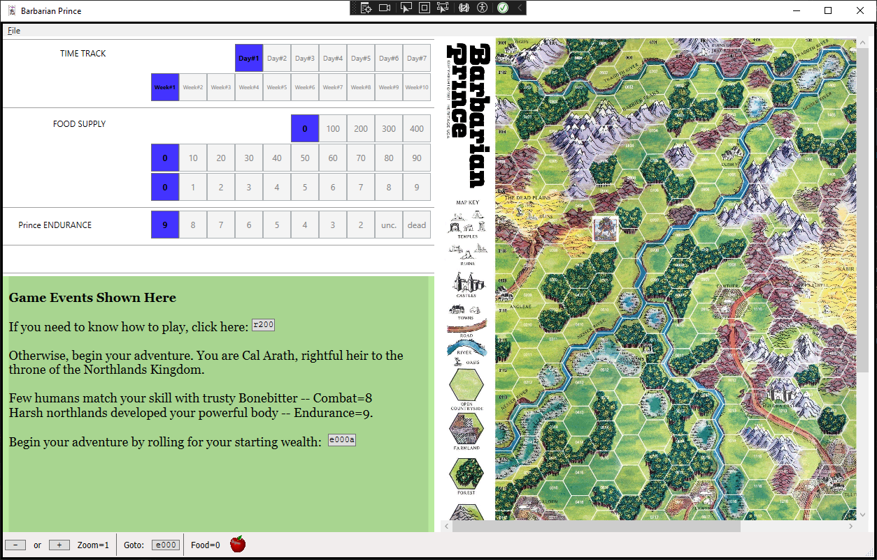
Screen Layout
MainMenuViewer
myStackPanelTimeTrackDay
GameViewerWindow handles myCanvas and status StackPanel’s
myStackPanelTimeTrackXXX
myStackPanelEndurance
myStackPanelDailyActions
myCanvas
EventViewer (and helper classes) populate GameViewerWindow->myTextBlock for game events
StatusBarViewer

Slide 5
Model

Slide 6
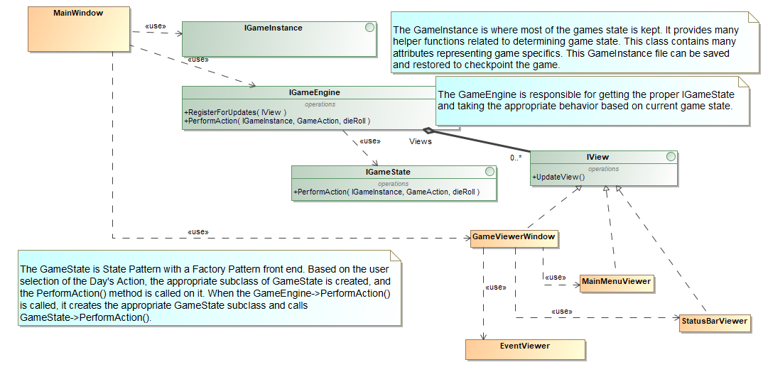
Model
MainWindow creates:
IGameInstance
IGameEngine
GameViewerWindow
GameEngine creates:
GameState
GameViewerWindow creates:
MainMenuViewer
StatusBarViewer
EventViewer

Slide 7
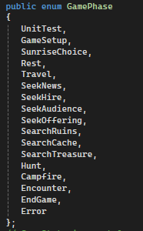
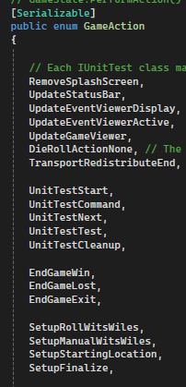
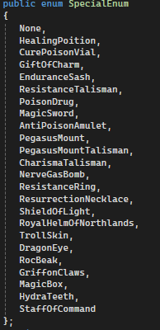
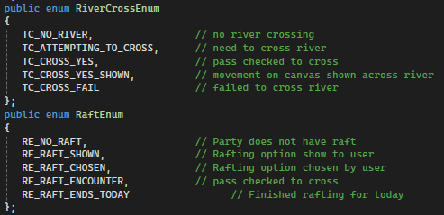
Important Structures
Enumerations are contained in IGameEngine
There are other minor enumerations to support very specific events.
Not all Actions Shown
GamePhase divides GameState into separate objects for easier understanding of the code. There is a direct correlation between GamePhase and subclasses of GameState.
GameStateEncounter is the largest class containing the most behavior.
SpecialEnum objects represent what Party Members can hold, i.e., their inventory. These items provide special abilities to the character.
GameAction is a very large list that feeds the GameState subclasses. There is a different GameAction per user interaction and a different GameAction per game event.

Slide 8
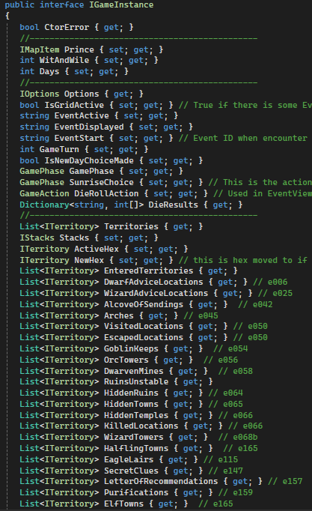
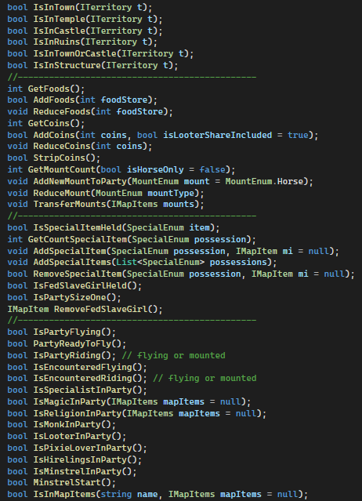
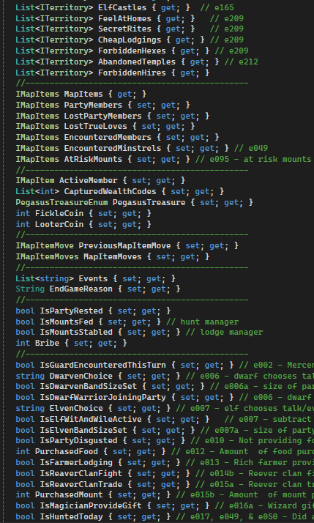
IGameInstance
Game state is stored in one large class called the GameInstance.
GameInstance is shared via method calls to most all objects during construction of the object.
Helper functions to support determining or changing game state
GameState that is shared by passing this as an object

Slide 9
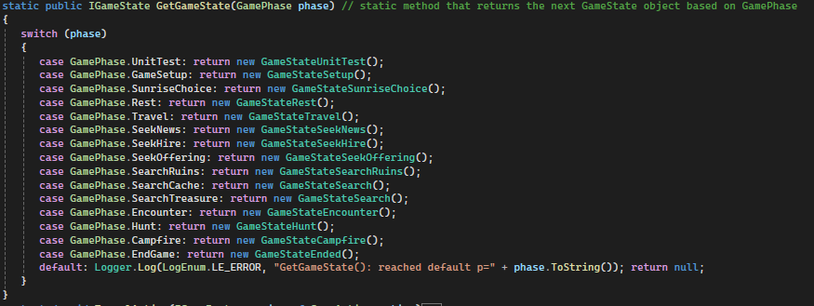
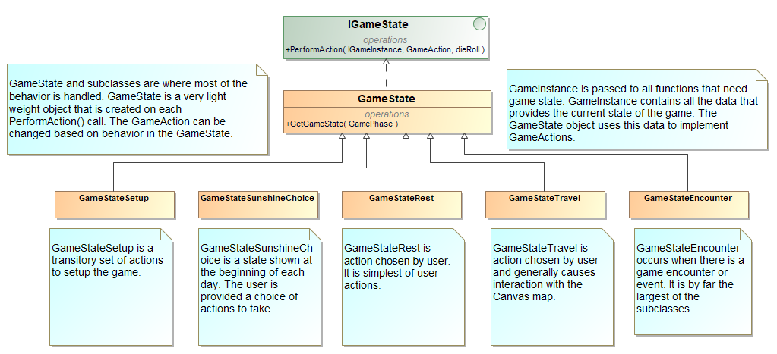
GameState
GetGameState()
GameState objects are lightweight objects that handle game behavior based on GamePhase.
Not all substates shown in diagram

Slide 10
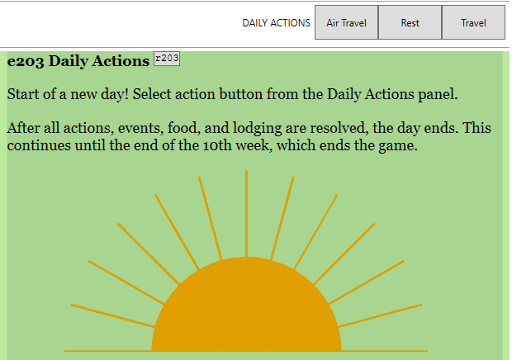
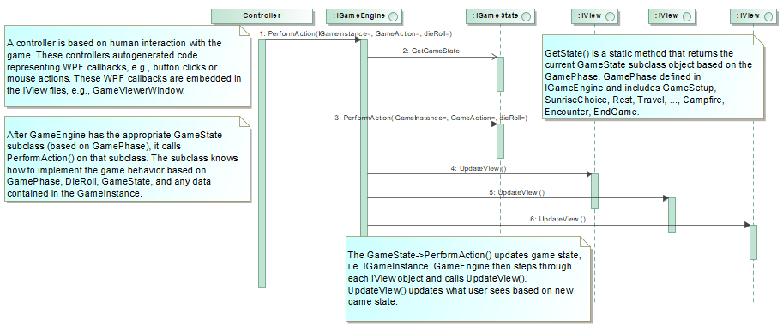
Model View Controller in Action

Slide 11
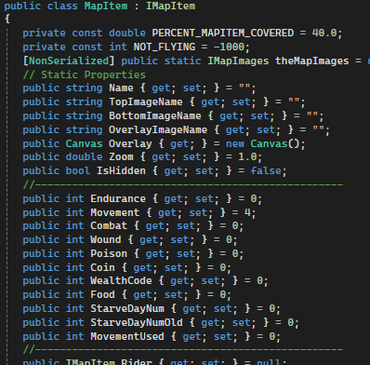
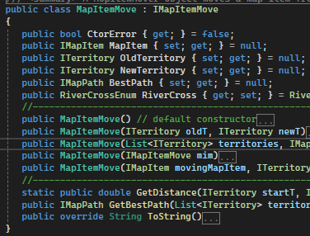
IMapItem
MapItems hold state that is specific to that party member or character
MapItemMove is an object that supports moving MapItems on the Canvas map.
MapItemMove contains the MapItem that correlates to what moves.
For this game, only the Prince is the MapItem shown on the map.
MapItem are objects shown on map or in EventViewer objects.
Each MapItem represents a party member or an encountered character.
IGameInstance holds myPartyMembers and myEncounteredMembers attributes which are containers for IMapItems.

Slide 12
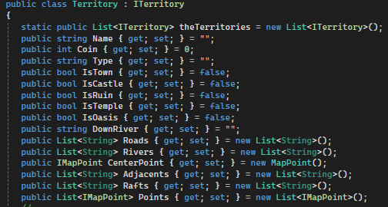
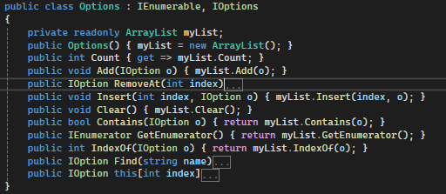
ITerritory
IOption
Territory holds the specifics of the hexes on the map
Options holds the user experience choices
For example, setting level of monster that party faces
.
GameInstance->Territories attribute read-in at startup from Territories.xml file
GameInstance->Options attribute read-in at startup from Options.xml file

Slide 13
Views

Slide 14
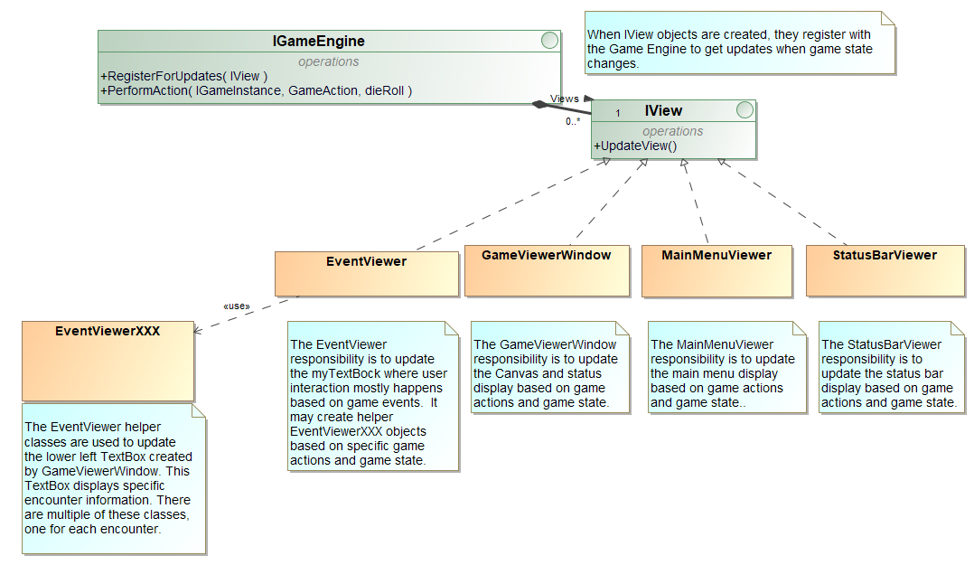
Views

Slide 15
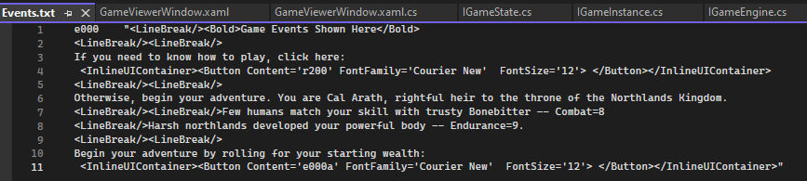
GameViewerWindow’s myTextBox
myTextBox is the main user interaction displaying information to the user shown in bottom left corner
The appropriate content to display in myTextBox is set by EventViewer or one of the EventViewerXXX helper classes
The source data for the myTextBox content is obtained from this file: Events.txt.
Events.txt generated from corresponding Events.xlsx spreadsheet
Text file representing rows in a spreadsheet
The text file must adhere to specific format
Two columns per row: 1.) event number (e.g., e000) 2.) XMAL representing what should be shown in myTextBox
Second column must not have double quotes embedded within the quotes
XAML is a markup language that supports WPF display of data in controls. WPF books provide specifics.

Slide 16
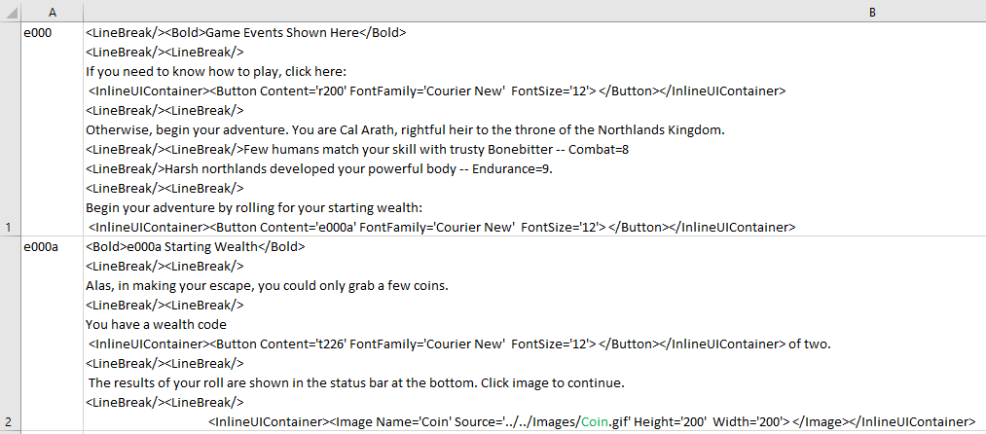
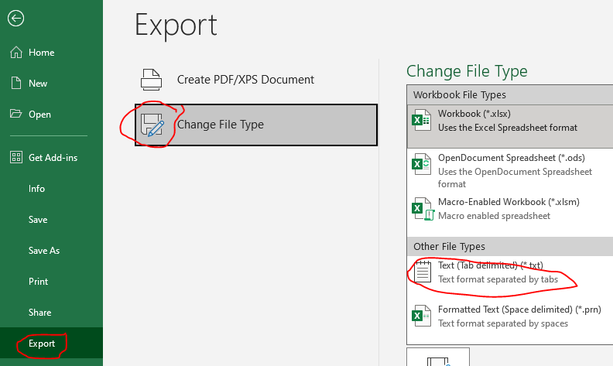
Convert Events.xlsx to Event.txt
Can manually convert updates to Events.xlsx to Event.txt file that is needed by application
In Excel, select File | Export…
Select the Change File Type option
Select Text file type
Save file as Events.txt in config directory
The application fails startup if an error was made in the XAML.
You cannot have double quotes in XAML
XAML must be properly formatted
Must exit text file before starting application to avoid double access.
Use “Save As” to save the xlsx file in the DesignDocs directory
Events and corresponding XAML that is displayed to user. Need to convert Events.xlxs to Event.txt file for application to read. Same applies to Rules.txt and Tables.txt.

Slide 17
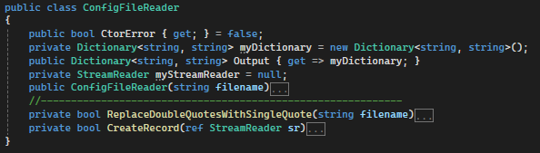
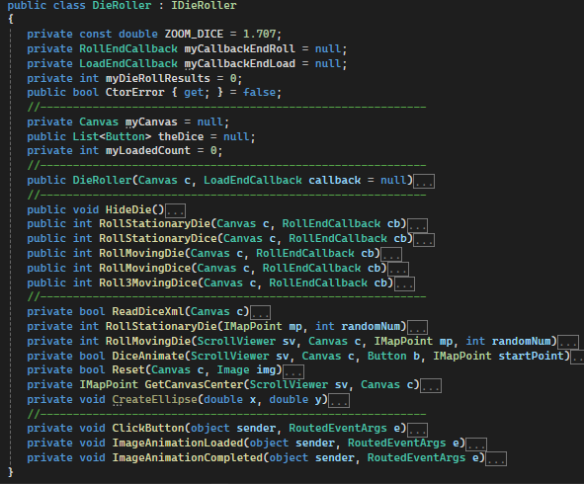
Other Helper Classes
ConfigFileReader object is responsible for reading Events.txt, Rules.txt, and Tables.txt to populate EventViewer->myEvents, EventViewer->myRules, and EventViewer->myTables for displaying data to user
DiceRoller is responsible for rolling one die, two die, or three die and making callback when done

Slide 18
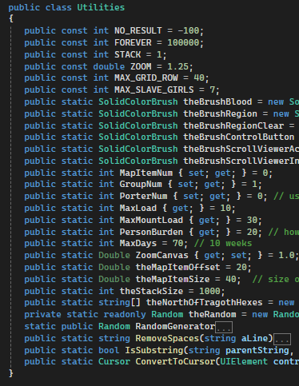
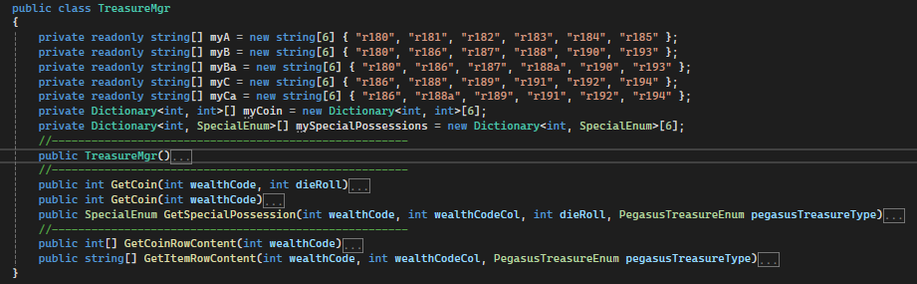

Other Helper Classes
TreasureMgr responsible for handling treasure table and what is returned when die rolls are made to get treasure
Cache handles when user caches items or money on the map
Utilities class holds static variables and constants that do not change

Slide 19
Testing

Slide 20
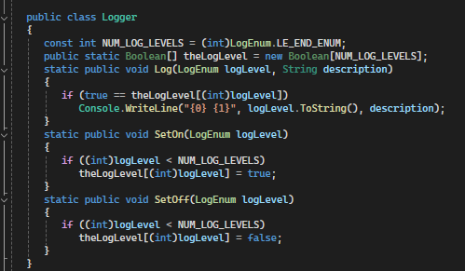
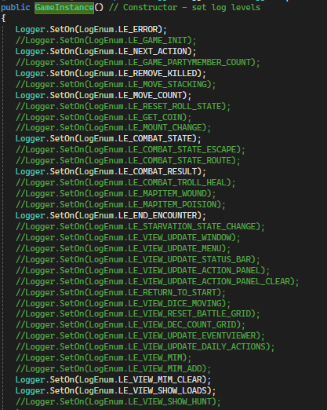
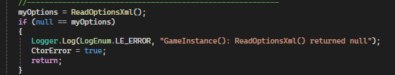
Logging
Logger Class
Logging turned on in GameInstance constructor
Example how to use logging

Slide 21
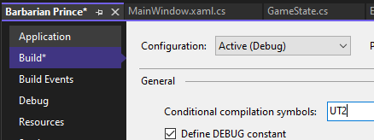
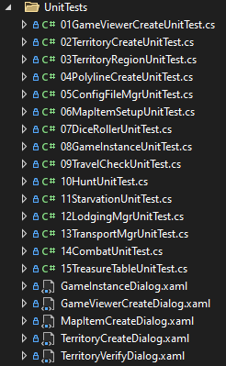
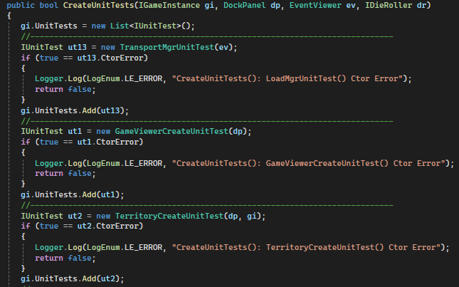
Unit Testing
UT2 compile directive creates unit test environment that specifically steps through all defined unit tests.
Game running environment is disabled and only the unit test framework is used
Requires knowledge of game to understand unit tests
Goals:
Test Creation of Territories, Graphical Objects, MapItems, MapItem Moves, etc
Test EventViewer objects
GameEngine->CreateUnitTests() active with UT1 compile directive
Steps through all unit tests

Slide 22
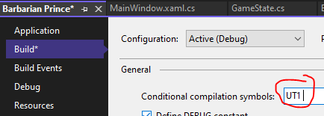
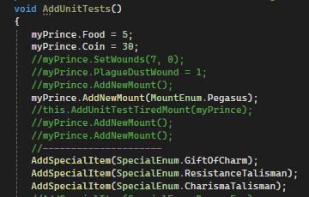
Unit Testing
UT1 compile directive creates extra game constructs during startup that support game events.
Turns on AddUnitTests() during IGameInstance construction where specific game state can be setup for testing in the game running environment

Slide 23
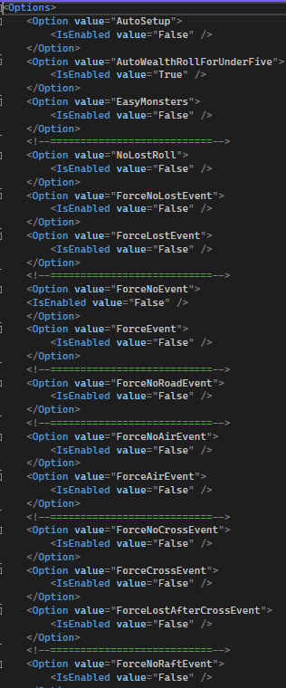
Unit Testing
Options.xml file can setup specific game state.
Can configure autosetup
Can configure no lost or force lost
Can configure no events or force events
Not Shown: Can configure starting party members

